Slide 1
Introduction to Computer Vision

Slide 2
Content
Computer Vision
What is OpenCV
Image manipulation
Masking and segmentation
Video Capturing
Manipulation
Segmentation
Edge Detection
Virtual Pen

Slide 3
Computer vision
Its the concept of computer understanding what it perceives. Its mainly used in object detection, machine learning, and self driving cars for it to understand its surroundings.
Computer vision can be performed with many sensors such as:
Camera
LiDAR
RADAR

Slide 4


Slide 5
What is OpenCV
Its an open-source library that aims to real time computer vision and image processing.
It provides an easy-to-use functions provided with it so that computer vision becomes more common and more widespread.
Examples:
Edge detection that helps in lane detection
Kalman filter that predicts the next steps
Image segmentation with masks
Image manipulation
We will learn image manipulation and masking in this session

Slide 6
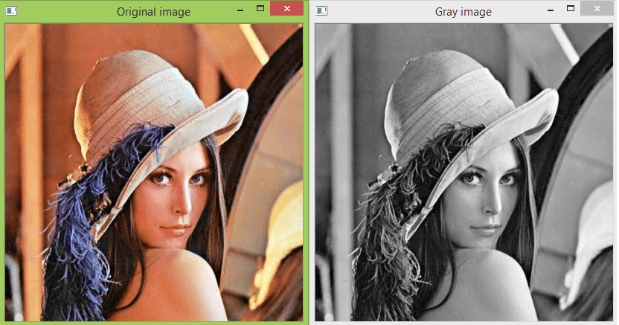
Image manipulation
The idea of editing the input image using the tools provided by OpenCV
The tool can do many different functionalities:
Change color models (Gray Scale – RGB – HSV)
Drawing shapes
Cropping
And much more…

Slide 7
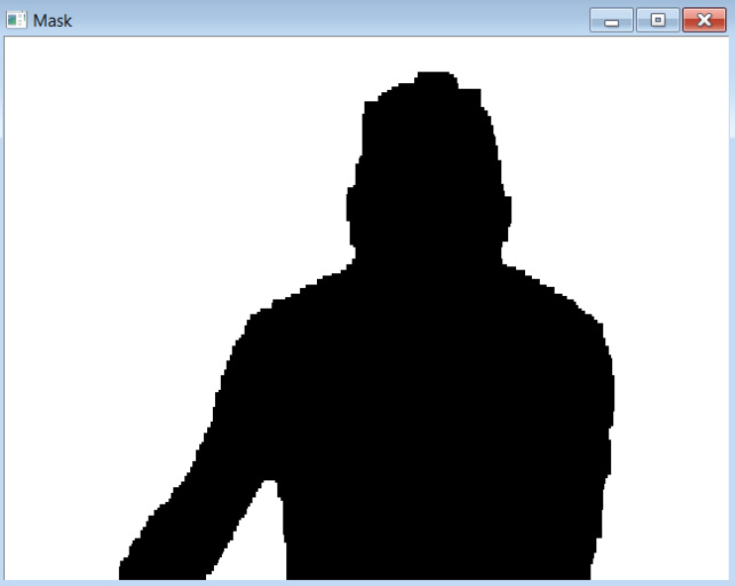
Masking and segmentation
Refers to isolating object of interest from the surrounding environment using different detection methods:
Color range
Edge detection
Object detection (if provided) as Mask RCNN

Slide 8
Video Capture
cv.VideoCapture():
Its used to get your video source either from camera or video file
(0) ➔ get real time video form webcam
(“path_to_video”) ➔ to load the video from the specified path
src.read():
Used to load the image frame by frame from the video source taken by cv.VideoCapture()

Slide 9
Image Capture
cv.VideoCapture(“image_path”):
It's used to get your image frame from specified path

Slide 10
Show Image
cv.imshow(“Window name”, img):
Used to show the image in the *img* bounded in a window and specify a name for it ”Window_name”
cv.waitKey(int)
Used with the cv.imshow() to determine the way of showing the image (still or live)
cv.waitKey(0) ➔ don’t update the window (in case of image to avoid instant closing)
cv.waitKey(1) ➔ used to wait 1ms between each update of the frame #can be any number

Slide 11
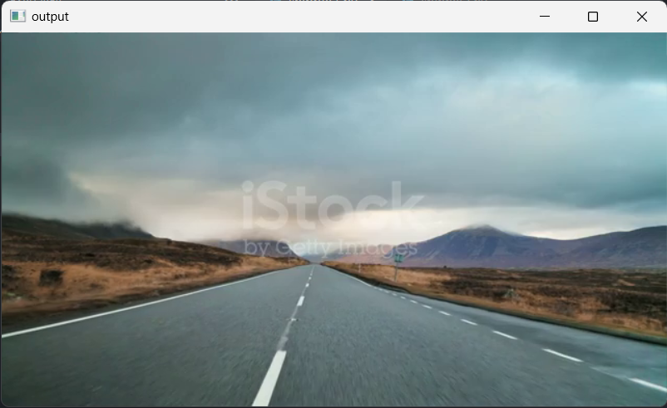
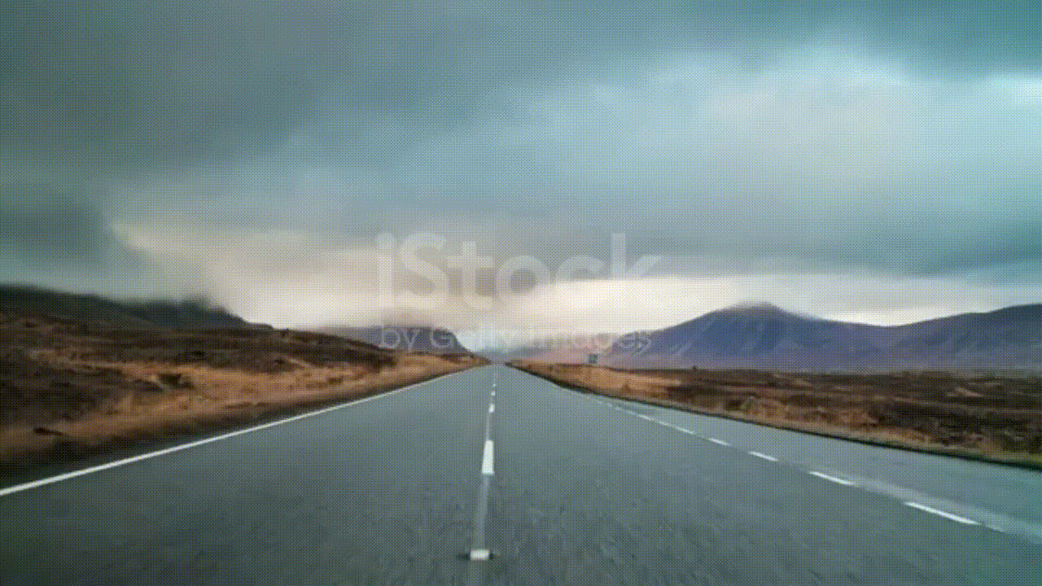

Slide 12
Manipulation
cv.putText(img, ‘TEXT’, origin, font, font_size, color, thickness)
cv.line(img, start_pt, end_pt, color, thickness) ➔ color = (b, g, r), pt = (x, y)
cv.rectangle(img, start_corner, end_corner, color, thickness)
cv2.circle(image, center_pt, radius, color, thickness)
*In shapes the thickness may be = -1 (indicate filled shape)*

Slide 13
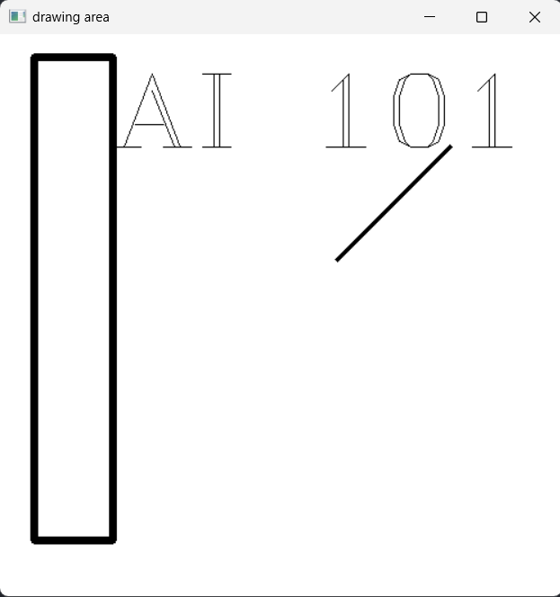

Slide 14
Segmentation
cv.inRange(image, lower_bound, upper_bound)
Lower and upper bounds are the indicator to which color range will be selected
This return a binary image where the selected pixels are = 255 and = 0 elsewhere
np.where()
Return array of X, Y of the selected pixels➔ [ [X Points], [Y Points] ]

Slide 15


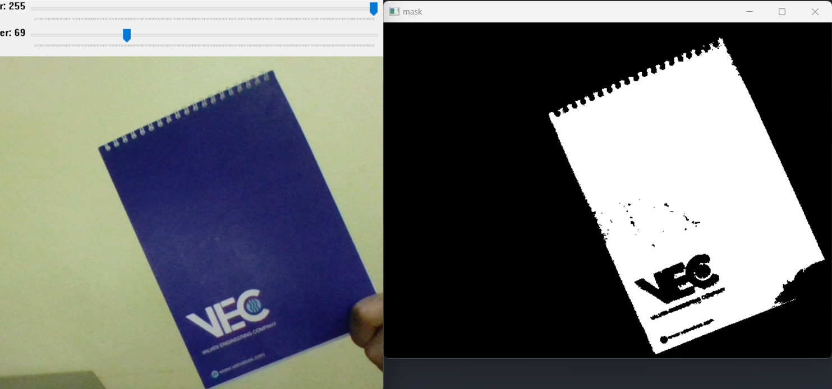

Slide 16
Edge detection
cv.Canny(image, lower_thresh, upper_thresh)
Lower and upper thresholds are the indicators to which an edge is considered as an edge or not
This return an image with the edge selected according to the threshold provided

Slide 17
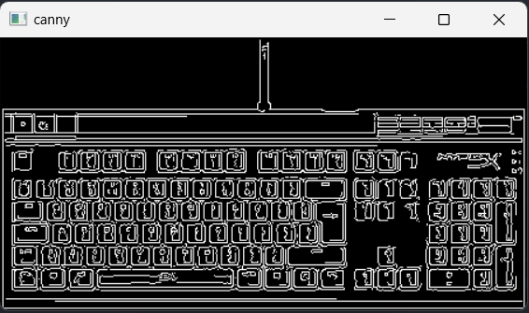

Slide 18
Virtual pen
Its main idea is detecting a color and draw circle in that point
It has 4 steps:
Reading video
Masking the color range needed
Clustering it to single point
Draw circle on the point

Slide 19
Its coding
time

Slide 20


